Slide 1

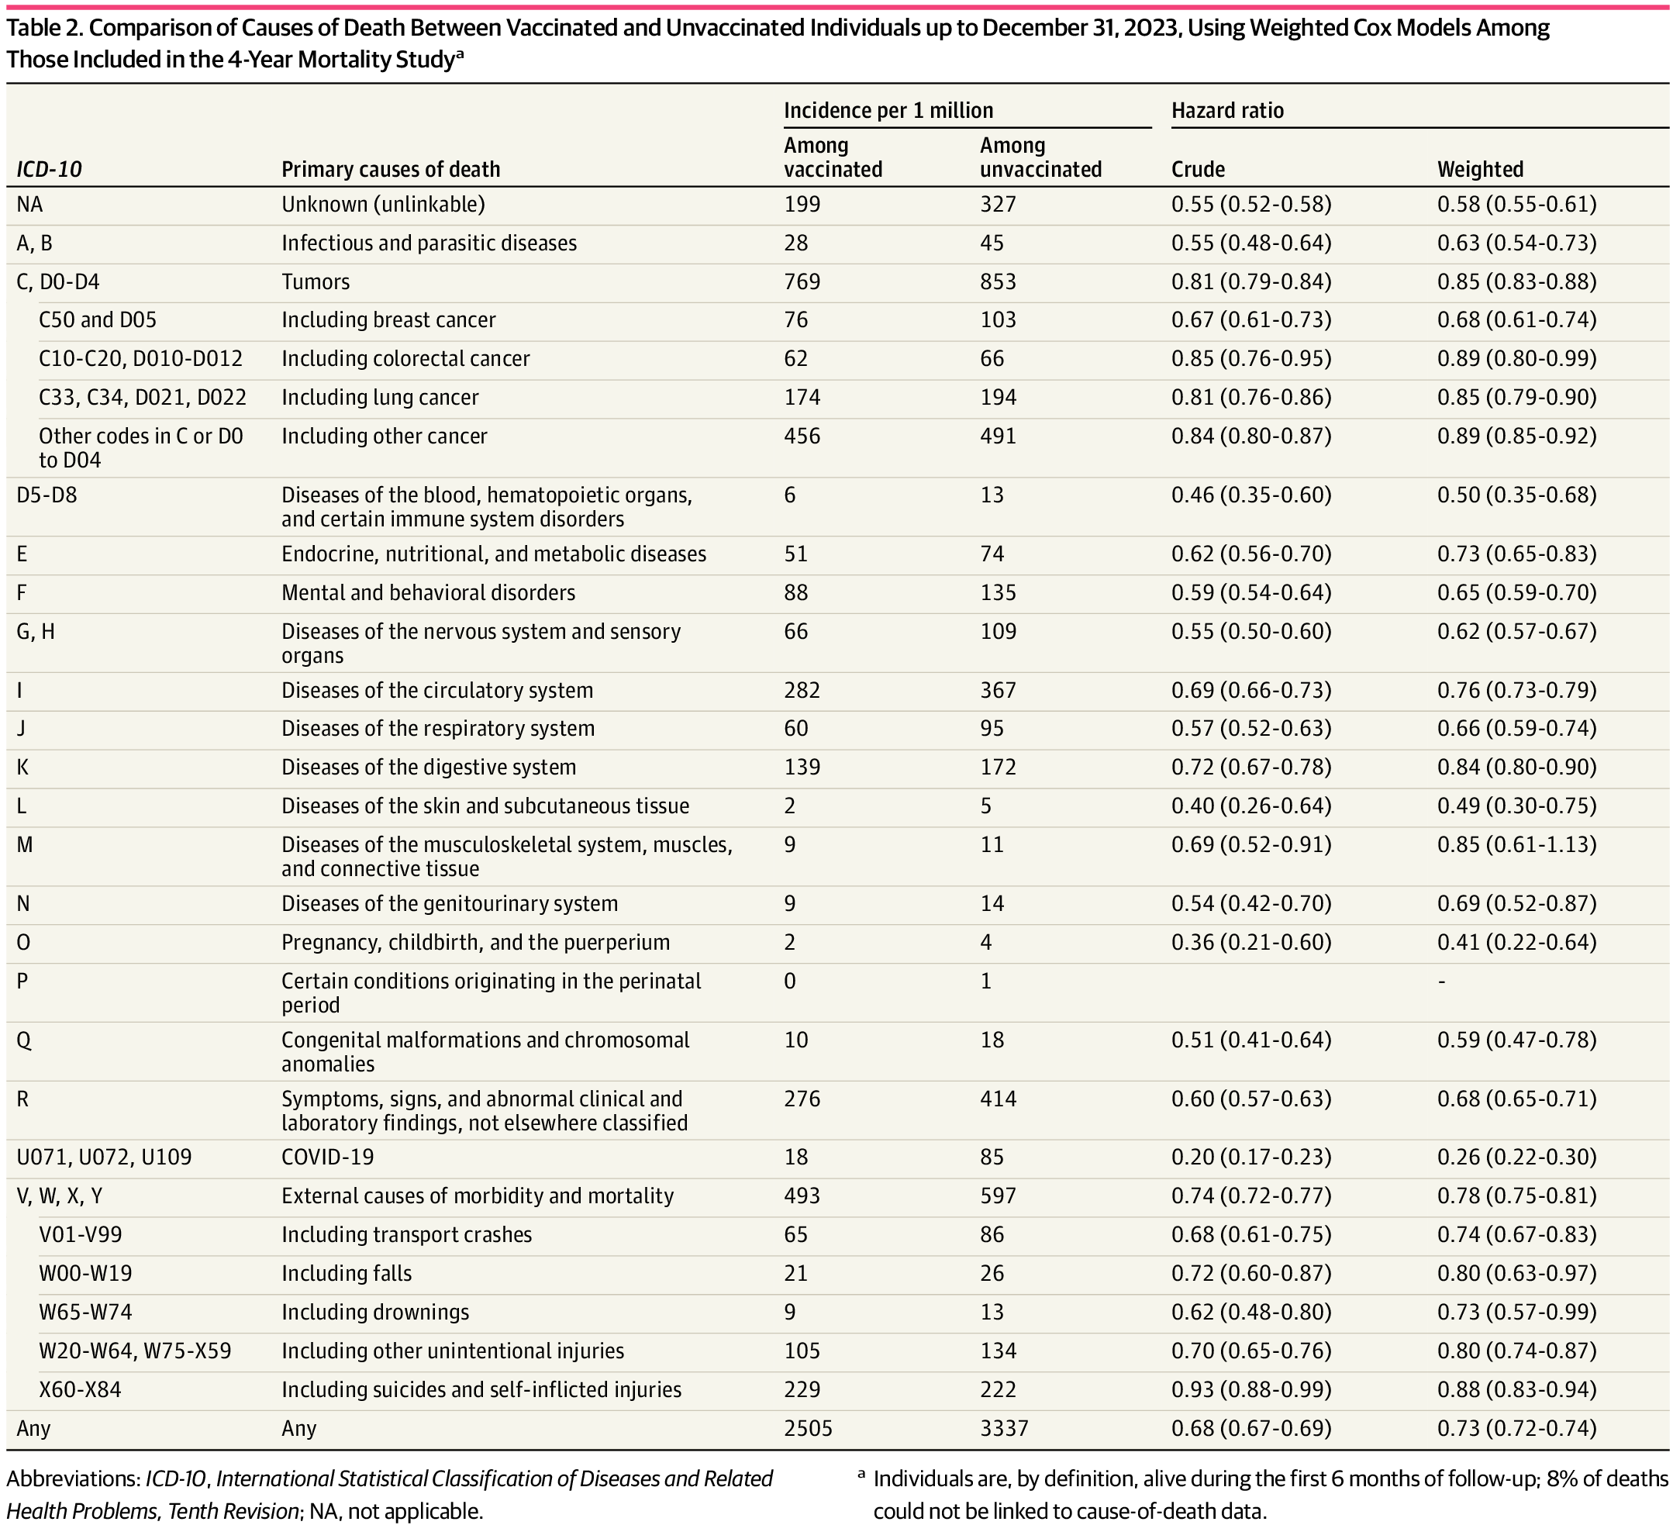
From: COVID-19 mRNA Vaccination and 4-Year All-Cause Mortality Among Adults Aged 18 to 59 Years in France
JAMA Netw Open. 2025;8(12):e2546822. doi:10.1001/jamanetworkopen.2025.46822
^{Table Title:}
Comparison of Causes of Death Between Vaccinated and Unvaccinated Individuals up to December 31, 2023, Using Weighted Cox Models Among Those Included in the 4-Year Mortality StudyªAbbreviations: ICD-10, International Statistical Classification of Diseases and Related Health Problems, Tenth Revision; NA, not applicable.
a Individuals are, by definition, alive during the first 6 months of follow-up; 8% of deaths could not be linked to cause-of-death data.
^{Date of download: 12/15/2025}

